Slide 1
Chapter 2 The System Unit, Processing, and Memory

Slide 2
Learning Objectives (1)
Understand how data and programs are represented to a computer and be able to identify a few of the coding systems used to accomplish this.
Explain the functions of the hardware components commonly found inside the system unit, such as the CPU, GPU, memory, buses, and expansion cards.
Describe how peripheral devices or other hardware can be added to a computer.
Understand how a computer’s CPU and memory components process program instructions and data.
2

Slide 3
Learning Objectives (2)
Name and evaluate several strategies that can be used today for speeding up the operations of a computer.
List some processing technologies that may be used in future computers.

Slide 4
Overview
This chapter covers:
How computers represent data and program instructions
How the central processing unit (CPU) and memory are arranged with other components inside the system unit
How a CPU performs processing tasks
Several strategies are used today to create faster and better computers today and in the future
4

Slide 5
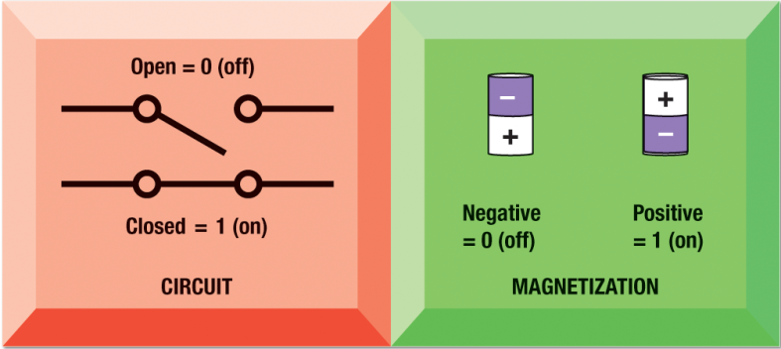
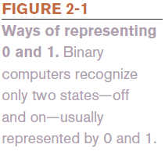
Data and Program Representation
Digital data representation is the process of representing data in digital form so it can be understood by a computer
Coding systems are used to represent data and programs in a manner understood by the computer
Digital computers can only understand two states, off and on (0 and 1)

Slide 6
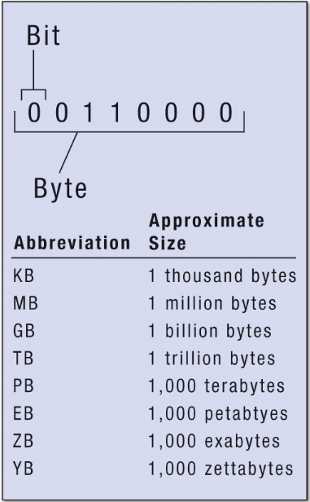
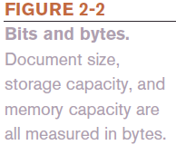
Digital Data Representation
A bit is the smallest unit of data that a binary computer can recognize (a single 1 or 0)
A byte is equivalent to 8 bits
Byte terminology used to express the size of documents and other files, programs, etc.
Prefixes are often used to express larger quantities of bytes: kilobyte (KB), megabyte (MB), gigabyte (GB), terabyte (TB), petabyte (PB), exabyte (EB), zettabyte (ZB ), yottabyte (YB)

Slide 7
Representing Numerical Data: The Binary Numbering System
The binary numbering system uses only two symbols (1 and 0) to represent all possible numbers
The numbering system computers use
The decimal numbering system uses 10 symbols (0-9)
The numbering system people use
In both systems, the position of the digits determines the power to which the base number (such as 10 or 2) is raised

Slide 8
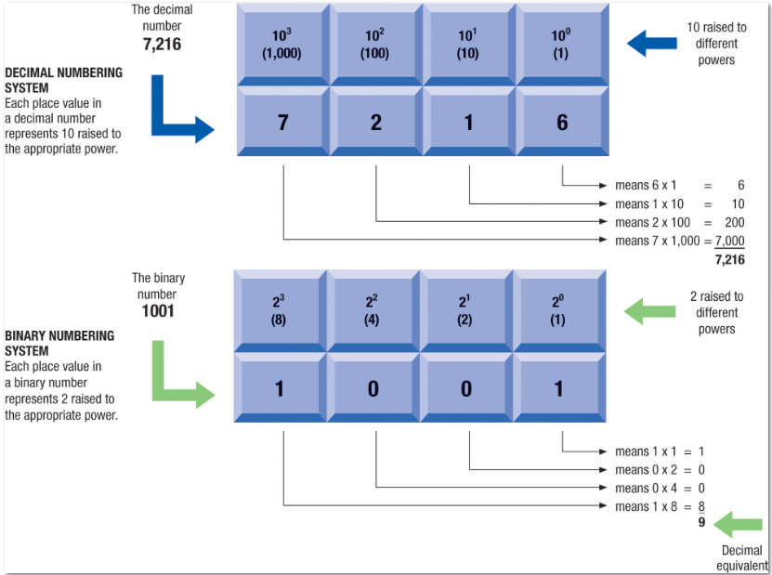
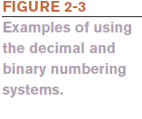
Example of the Decimal and Binary Numbering Systems

Slide 9
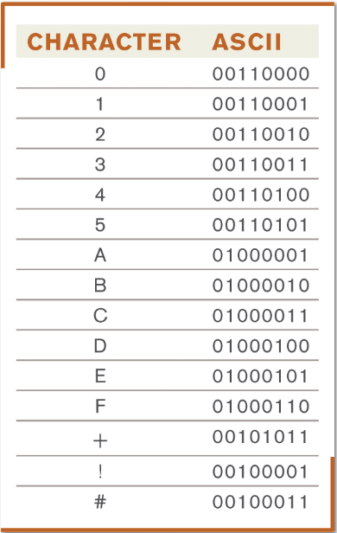
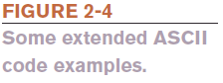
Coding Systems for Text-Based Data: ASCII and EBCDIC
ASCII (American Standard Code for Information Interchange) is the coding system traditionally used with personal computers
Most commonly uses 8 bits
EBCDIC (Extended Binary-Coded Decimal Interchange Code)
Developed by IBM, primarily for mainframes

Slide 10
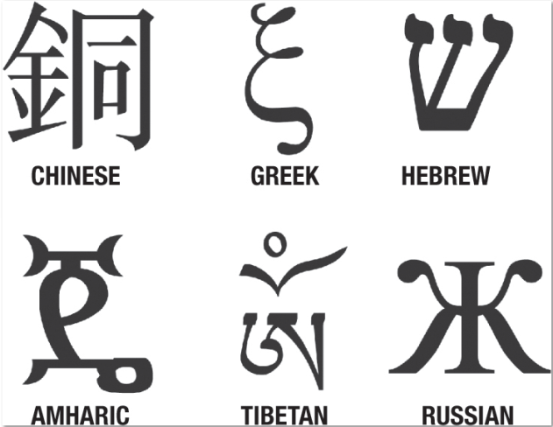
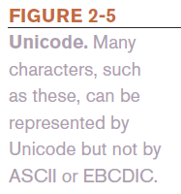
Coding Systems for Text-Based Data: Unicode
Unicode
Newer code consisting of 8 to 32 bits per character
Universal coding standard designed to represent text-based data written in any ancient or modern language, as well as thousands of other symbols and signs
Replacing ASCII as the primary text-coding system

Slide 11
Coding Systems for Other Types of Data: Graphics Data
Graphics data (still images such as photos or drawings) consist of bitmapped images made up of a grid of small dots called pixels
Monochrome graphic can only be one of two colors
Requires just one bit for color storage
Images with more than two colors
Can use 4, 8, or 24 bits to store the color data for each pixel
The number of bits per pixel depends on the type of image
JPEG images taken by most digital cameras today use 24-bit true color images; large images can typically be compressed
Common image formats include TIF, BMP, GIF, and PNG

Slide 12
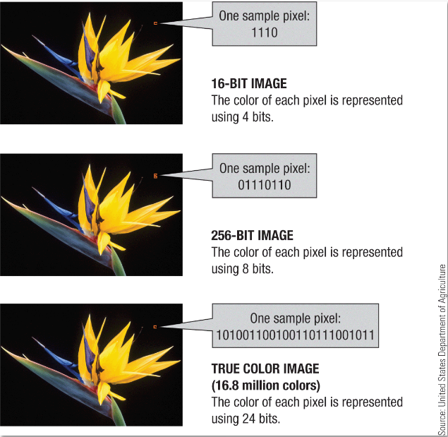
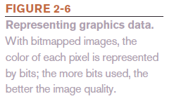
Representing Graphics Data

Slide 13
Coding Systems for Other Types of Data: Audio and Video Data
Audio data must be in digital form in order to be stored on or processed by a computer
Often compressed when sent over the Internet
MP3 files are 10 times smaller than their uncompressed digital versions
Compressed files download more quickly and take up less storage space
Video data is displayed using a collection of frames, each frame contains a still image
Amount of data can be substantial, but can be compressed

Slide 14
Representing Software Programs: Machine Language
Machine language is a binary-based language for representing computer programs the computer can execute directly
Early programs were written in machine language
Today’s computers allow programs to be written in a programming language, which is then translated by the computer into machine language in order to be understood by the computer

Slide 15
Quick Quiz (1)
1. Another way to say “one trillion bytes” is _____.
a. one gigabyte
one terabyte
one megabyte
2. True or False: MP3 files are stored using 0s and 1s.
3. The _____________ numbering system is used by computers to perform mathematical computations.

Slide 16
Quick Quiz (1)
Answers:
b
True
binary

Slide 17
Inside the System Unit
The system unit is the main case of a computer or mobile device
Houses the processing hardware for a computer
Also contains other components, such as storage devices, the power supply, cooling hardware, one or more processors, several types of memory, and interfaces to peripheral devices
Interconnected through sets of wires called buses on the motherboard

Slide 18
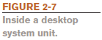
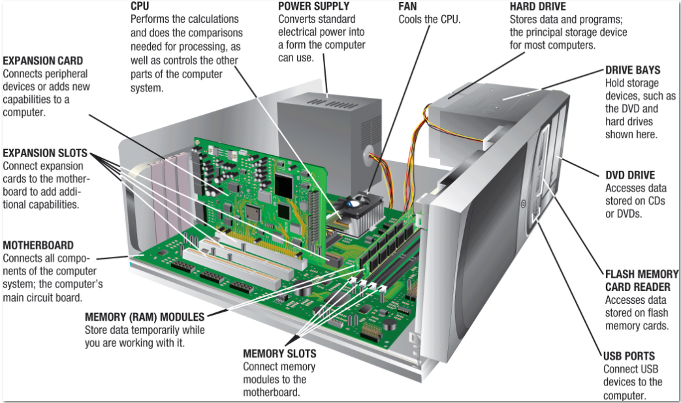
Inside a Desktop System Unit

Slide 19
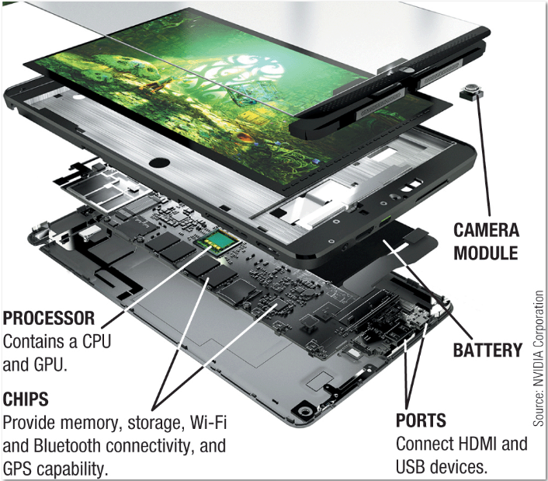
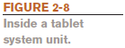
Inside a Tablet System Unit

Slide 20
The Motherboard
The motherboard is a circuit board consisting of computer chips, also called integrated circuits (ICs)
ICs contain interconnected components (such as transistors) to perform particular functions
All devices connect via a wired or wireless connection to the motherboard
External devices connect by plugging into a port
The port is either built directly into the motherboard or created via an expansion card
Wireless external devices use either a transceiver or wireless networking technology

Slide 21
The Power Supply and Drive Bays
The power supply connects to the motherboard to deliver electricity
Portable computers use a rechargeable battery pack
Built-in batteries more difficult and expensive to replace, resulting in electronic waste (e-waste)
Drive bays are rectangular metal racks inside the system unit that house storage devices
Hard drive, CD/DVD drive, flash memory card reader
Storage devices also connect to the motherboard

Slide 22
Processors and the CPU
A processor consists of circuitry and components packaged together and connected directly to the motherboard
The CPU (central processing unit) does the vast majority of processing for a computer
Called a microprocessor when talking about personal computers
Typically designed for a specific type of computer
Desktops, servers, and some notebook PCs use Intel or Advanced Micro Devices (AMD) processors
Portable computers and mobile devices often use Intel or AMD mobile processors or an ARM processor instead

Slide 23
CPU Cores
Multi-core CPUs contain the processing components (cores) of multiple independent processors in a single CPU
Dual-core CPUs contain two cores
Quad-core CPUs contains four cores
Multi-core processors allow computers to work on more than one task at a time
They also typically use slower cores than single-core CPUS so have fewer heat problems

Slide 24
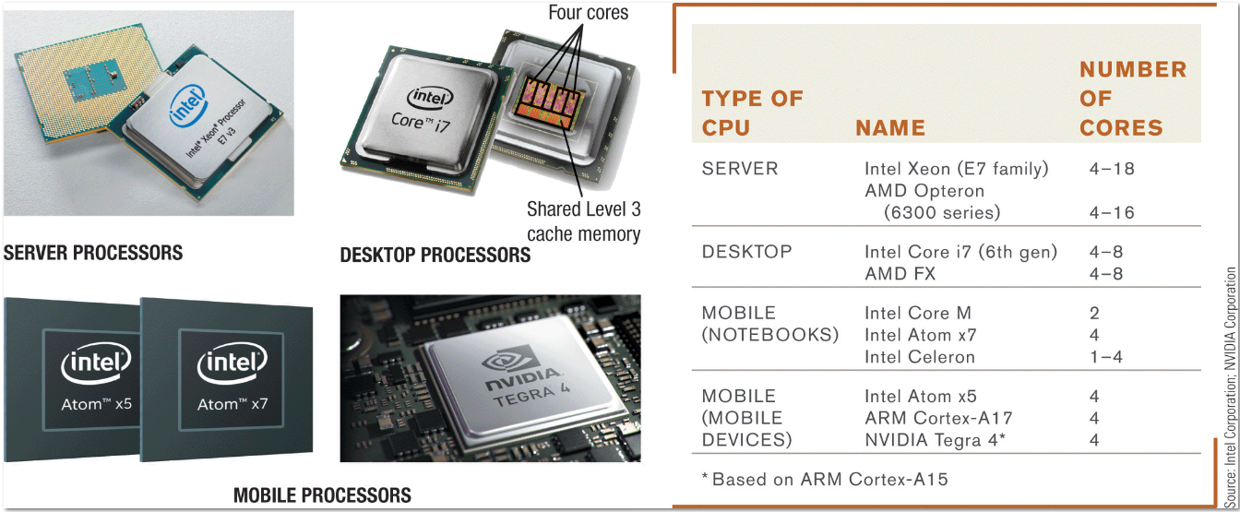
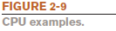
Examples of CPUs

Slide 25
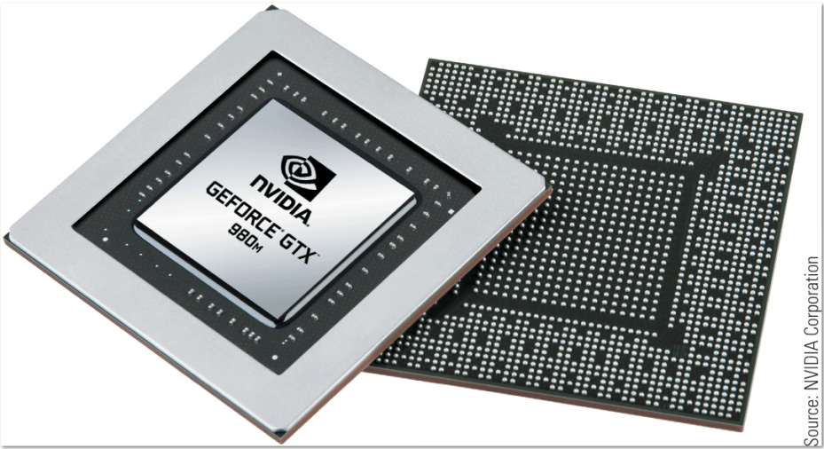
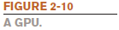
The GPU
The GPU (graphics processing unit) takes care of the processing needed to display images (including still images, animations) on the screen
Can be located on the motherboard, on a video graphics board, or in the CPU package
Mobile processors often integrate other capabilities into the processor package (system-on-a-chip (SoC))

Slide 26
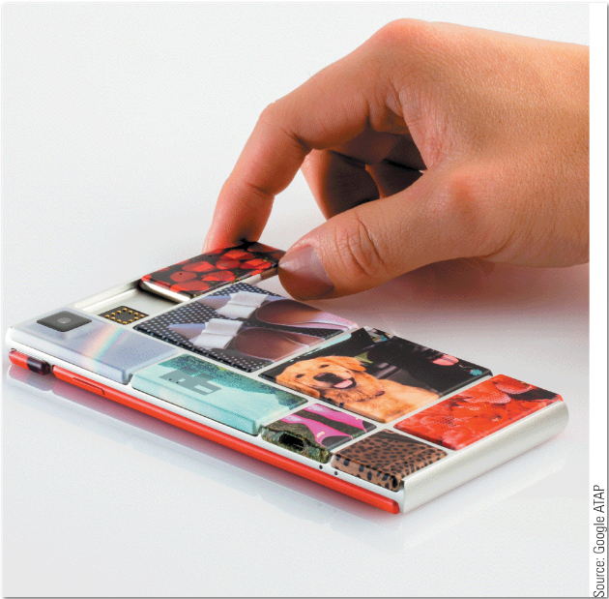
Technology and You
Modular Phones
Currently in development
Individuals create custom phones
Start with basic modules
Give the user flexibility to add, upgrade, or replace modules whenever
Google’s Project Ara
Google’s modular smartphone prototype.

Slide 27
Processing Speed
Processing speed can be measured by the CPU’s clock speed
Rated in megahertz (MHz) or gigahertz (GHz)
Higher CPU clock speed = more instructions processed per second
Alternate measure of processing speed is the number of instructions a CPU can process per second
Megaflops (millions), gigaflops (billions), teraflops (trillions)
Benchmark tests can be used to evaluate overall processing speed

Slide 28
Word Size and Cache Memory
A computer word is the amount of data that a CPU can manipulate at one time
In the past, CPUs used 32-bit words (referred to as 32-bit processors); today, most CPUs are 64-bit processors
Cache memory is a special group of very fast circuitry usually built into the CPU (internal cache memory)
More cache memory typically means faster processing
Cache memory level numbers indicate the order in which the various levels of cache are accessed by the CPU
Level 1 is fastest, then Level 2, then Level 3

Slide 29
Bus Width, Bus Speed, and Bandwidth
A bus is an electronic path over which data can travel
Found inside the CPU and on the motherboard
Bus width is the number of wires in the bus over which data can travel
A wider bus allows more data to be transferred at one time
Bus width and bus speed together determine the bus’s bandwidth (the amount of data that can be transferred via the bus in a given time period)
The amount of data actual transferred under real-life conditions is called throughput

Slide 30
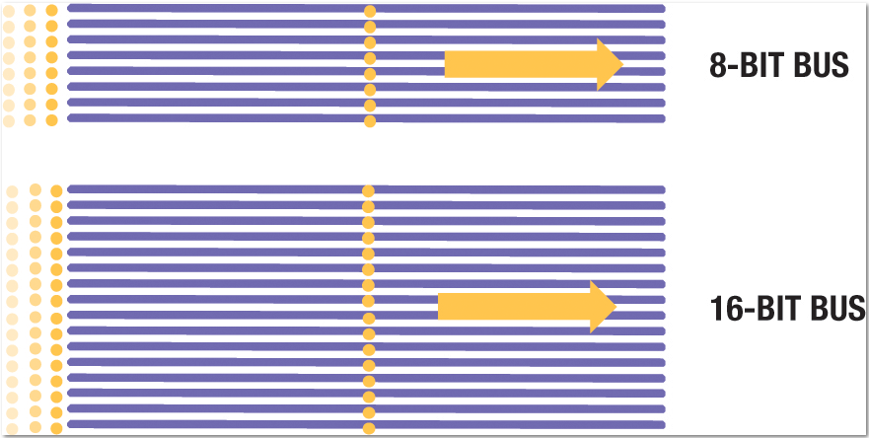
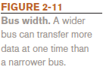
Example of Bus Width

Slide 31
Memory
Memory refers to chip-based storage, or locations that a computer uses to store data on a temporary basis
Volatile memory (content is erased when the device is shut off)
Non-volatile memory (content is retained when the device is shut off)
Random access memory (RAM) is the computer’s main memory or system memory
Stores essential parts of operating system, programs, and data the computer is currently using
Consists of electronic circuits etched onto chips
Mobile devices typically use embedded memory chips
Servers and personal computers use circuit boards called memory modules plugged into the motherboard

Slide 32
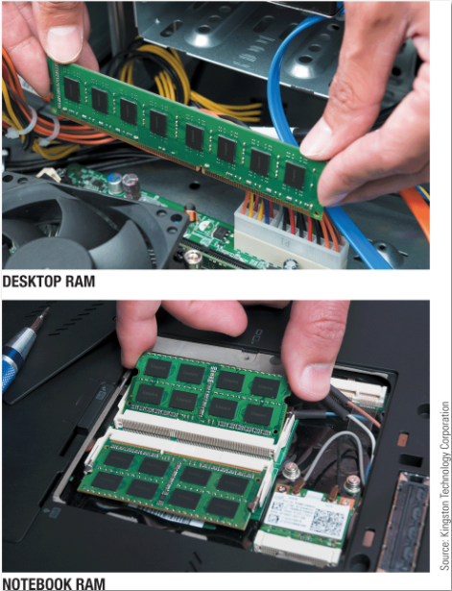
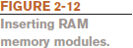
Inserting RAM Memory Modules

Slide 33
Characteristics of RAM
Volatile
Measured in bytes (amount dependent on CPU and operating system)
Most personal computers use SDRAM
Double-Data Rate (DDR) RAM sends data twice as often as ordinary SDRAM or prior versions of RAM
DDR2, DDR3, DDR4
Dual-channel memory architecture has two paths that go to and from memory; tri-channel (three paths) and quad-channel (four paths) memory architecture used for higher performance

Slide 34
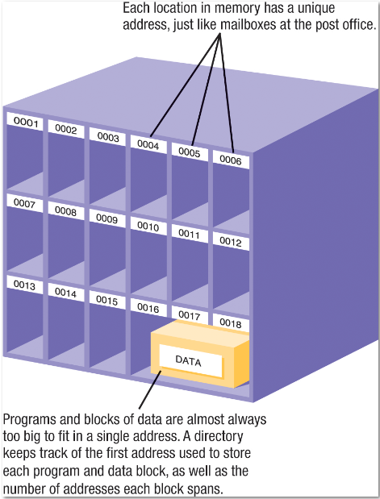
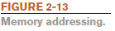
Memory Addressing
Each location in memory has an address
Usually stored in one or more consecutive addresses, depending on its size
Computer system sets up and maintains directory tables to facilitate retrieval of the data

Slide 35
Registers and ROM
Registers are high-speed memory locations built into the CPU
Used to store data and intermediary results during processing
Fastest type of memory
ROM (read-only memory) consists of non-volatile chips located on the motherboard into which data or programs have been permanently stored
Retrieved by the computer when needed
Being replaced with flash memory

Slide 36
Flash Memory
Flash memory consists of nonvolatile memory chips that can be used for storage
Have begun to replace ROM for storing system information (BIOS)
Stores firmware for personal computers and other devices
Built into many types of devices (tablets, smartphones, and digital cameras) for user storage
Built into some storage devices (solid-state hard drives, USB flash drives, etc.)

Slide 37
Fans, Heat Sinks, and Other Cooling Components
Fans are used on most personal computers to help cool the CPU and system unit
Heat is an ongoing problem for CPU and computer manufacturers
Can damage components
Cooler chips run faster
Heat sinks are small components typically made out of aluminum with fins that help to dissipate heat
Some portable computers and virtually all mobile devices don’t include a fan; instead thermal transfer materials are used to spread out the heat generated

Slide 38
Other Types of Cooling Systems
Liquid cooling systems
Cool the computer with liquid-filled tubes
Immersion cooling
Hardware is actually submerged into units filled with a liquid cooling solution
Notebook cooling stand
Cools the underside of a notebook computer
Other cooling methods, such as ion pump cooling systems, are under development

Slide 39
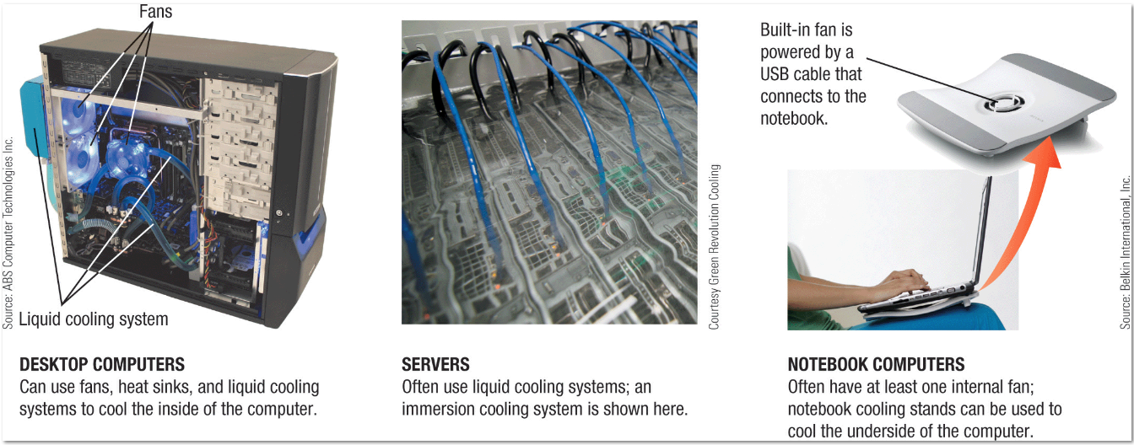
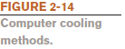
Examples of Computer Cooling Methods

Slide 40
Expansion Slots and Expansion Cards
An expansion slot is a location on the motherboard into which expansion cards are inserted
An expansion card is a circuit board inserted into an expansion slot
Used to add additional functionality or to attach a peripheral device
Smaller devices may integrate capabilities directly into the device
USB adapters can be used with portable computers and some mobile devices

Slide 41
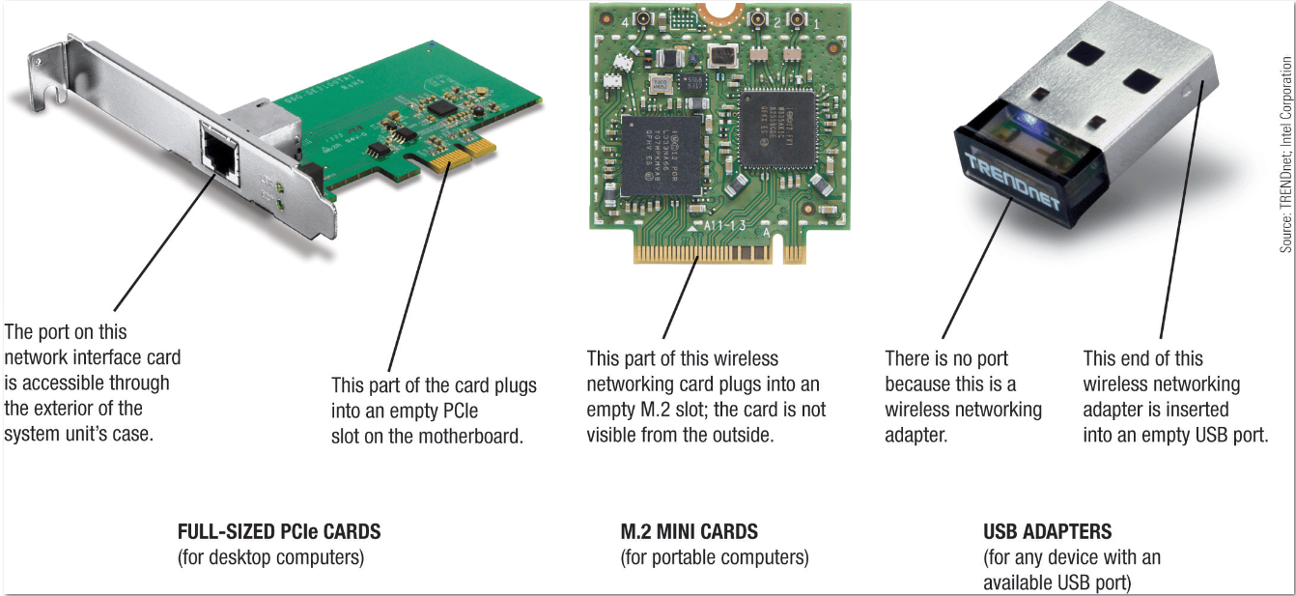
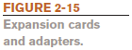
Examples of Expansion Cards and Adapters

Slide 42
Buses
A bus is an electronic path within a computer over which data travels
Located within the CPU and etched onto the motherboard
An expansion bus connects the CPU to peripheral (typically input and output) devices
The memory bus connects the CPU directly to RAM
The frontside bus (FSB) connects the CPU to the chipset that connects the CPU to the rest of the bus architecture

Slide 43
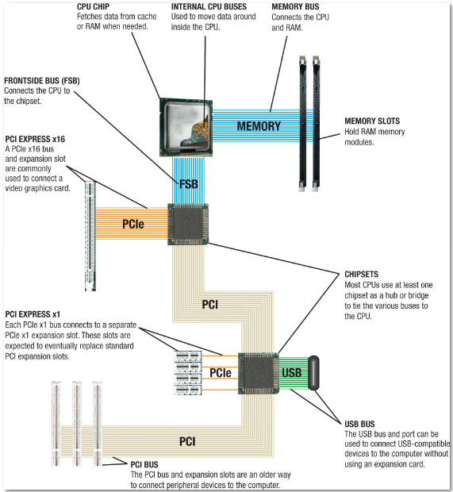
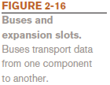
Examples of Buses and Expansion Slots

Slide 44
PCI, PCIe, and USB
The PCI bus used to be the most common type of expansion bus
Today, PCI Express (PCIe) buses are more common
PCIe x16 is a 16-bit bus and is used to connect monitors to a computer
PCIe x1 is a 1-bit bus and is used to connect other peripherals
PCIe buses are extremely fast
A universal serial bus (USB) connects USB devices to a computer
127 different devices can connect via a single USB port
Extremely versatile

Slide 45
Ports and Connectors
A port is a connector on the exterior of a computer’s system unit to which a device may be attached
Typical desktop computer ports HDMI to connect a monitor (VGA and Digital Video Interface (DVI) are older standards)
Network ports connect a device to a wired network
USB ports connect USB devices; can be USB-C
Others include IrDA and Bluetooth ports, flash memory card slots, audio ports, eSATA ports, and Thunderbolt ports (Apple)
Most computers support the Plug and Play standard
USB and Thunderbolt devices are hot-swappable

Slide 46
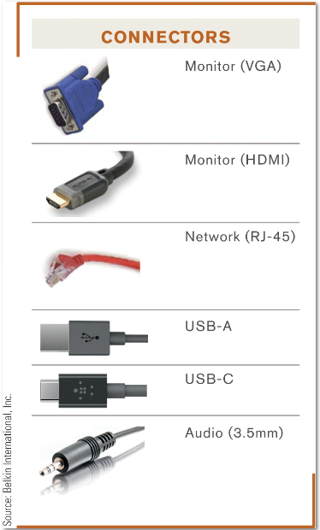
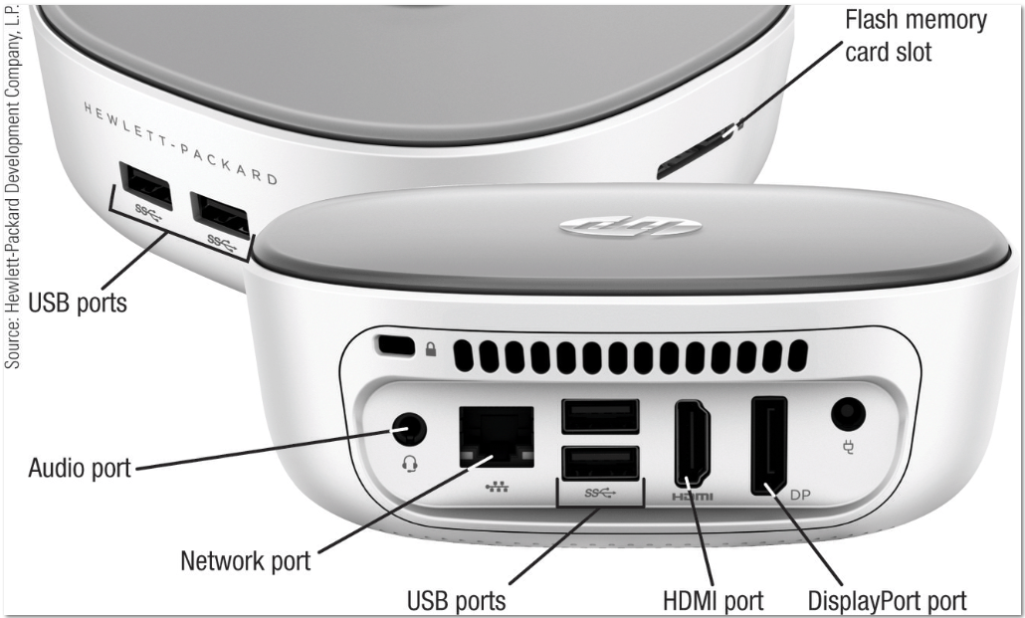
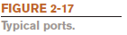
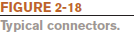
Examples of Typical Ports and Connectors

Slide 47
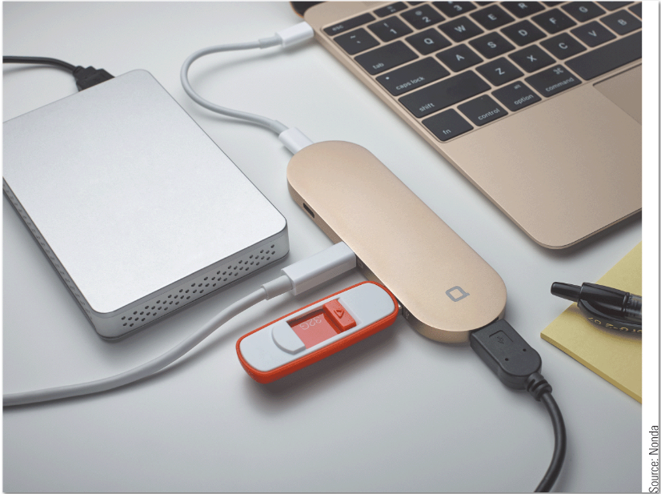
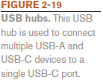
USB Hubs
USB hubs connect multiple devices to a single USB port

Slide 48
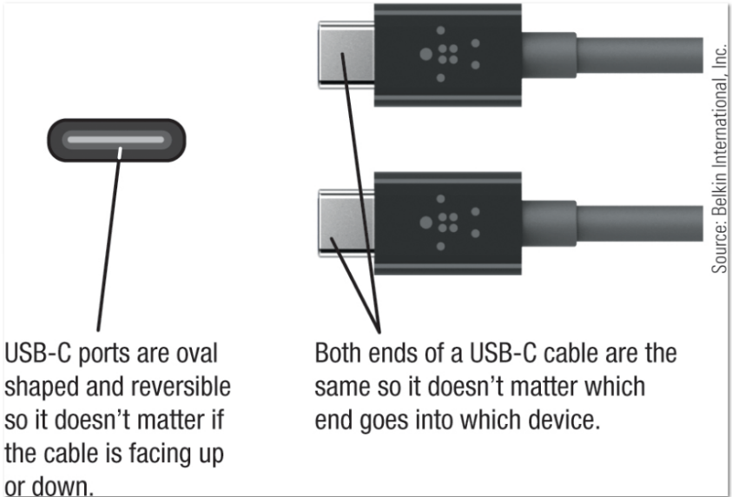
How It Works
USB-C
Both ends of a USB-C cable are the same
Traditional USB cables have two different connectors:
USB-A and USB-B
Very fast
Can charge and power portable computers
Many types of adapters and multiport adapter cables available
USB-C ports are oval shaped; cables are reversible and interchangeable.

Slide 49
Ports and Connectors: Tablets and Smartphones
Tablets have ports similar to desktop computers, but often not as many
Connecting a tablet to a tablet dock can provide additional connectivity options
Smartphones have more limited expansion capabilities
Usually have a USB port
Some have a flash memory card slot
Some have a Subscriber Identify Module (SIM) slot to hold a SIM card

Slide 50
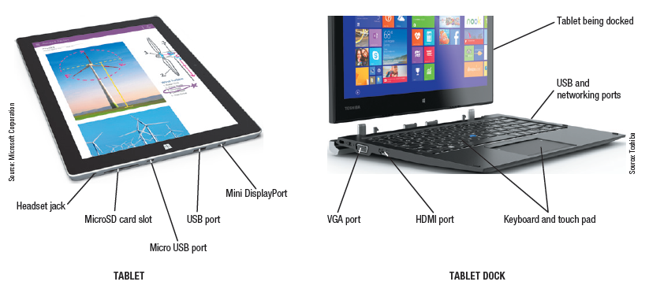
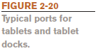
Examples of Typical Ports for Tablets and Tablet Docks

Slide 51
Quick Quiz (2)
1. Which type of memory is erased when the power goes out?
a. ROM
b. RAM
c. flash memory
2. True or False: The CPU can also be called the motherboard.
3. An electronic path within a computer over which data travels is called a(n) _____________.

Slide 52
Quick Quiz (2)
Answers:
B
False
bus

Slide 53
How the CPU Works
The CPU (central processing unit) consists of a variety of circuitry and components packaged together
The transistor is the key element of the microprocessor
Made of semi-conductor material that controls the flow of electrons inside a chip
Today’s CPUs contain hundreds of millions of transistors; the number doubles about every 18 months (Moore’s Law)
Electronic impulses move from one part of the CPU to another to process data
The architecture and components included in a CPU (referred to as microarchitecture) vary from processor to processor

Slide 54
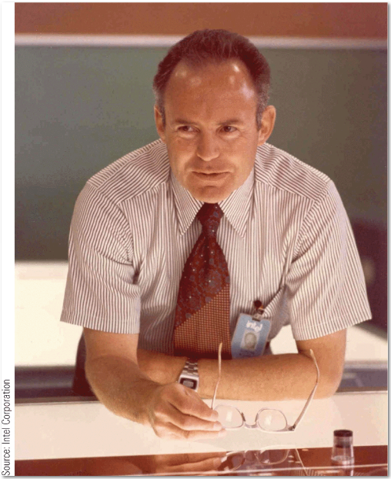
Inside the Industry
Moore’s Law
In 1965, Gordon Moore predicted that the number of transistors per square inch on chips had doubled every two years and that trend would continue
Moore’s Law is still relevant today for processors as well as other computer components
George Moore (1970)

Slide 55
CPU Core Components
The arithmetic/logic unit (ALU) performs arithmetic involving integers and logical operations
The floating point unit (FPU) performs decimal arithmetic
The control unit coordinates and controls activities within a CPU core
The prefetch unit attempts to retrieve data and instructions before they are needed for processing in order to avoid delays

Slide 56
CPU Core Components (cont’d)
The decode unit translates instructions from the prefetch unit so that they are understood by the control unit, ALU, and FPU
The registers and internal cache memory store data and instructions needed by the CPU
The bus interface unit allows the core to communicate with other CPU components

Slide 57
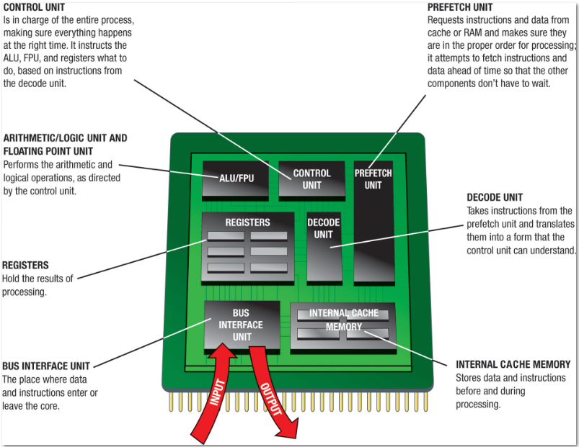
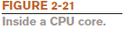
Inside a CPU Core

Slide 58
The System Clock
The system clock is a timing mechanism within the computer system that synchronizes the computer’s operations
Located on the motherboard
Sends out a signal on a regular basis to all computer components
Each signal is a cycle
Number of cycles per second is measured in hertz (Hz)
One megahertz = one million ticks of the system clock

Slide 59
Clock Speed
Computers can run at a multiple or fraction of the system clock speed
Many PC system clocks run at 200 MHz; all devices run at a fraction or multiplier of the clock speed
A CPU clock speed of 2 GHz means the CPU clock “ticks” 10 times during each system clock tick
During each CPU clock tick, one or more pieces of microcode are processed
A CPU with a higher clock speed processes more instructions per second than the same CPU with a lower CPU clock speed

Slide 60
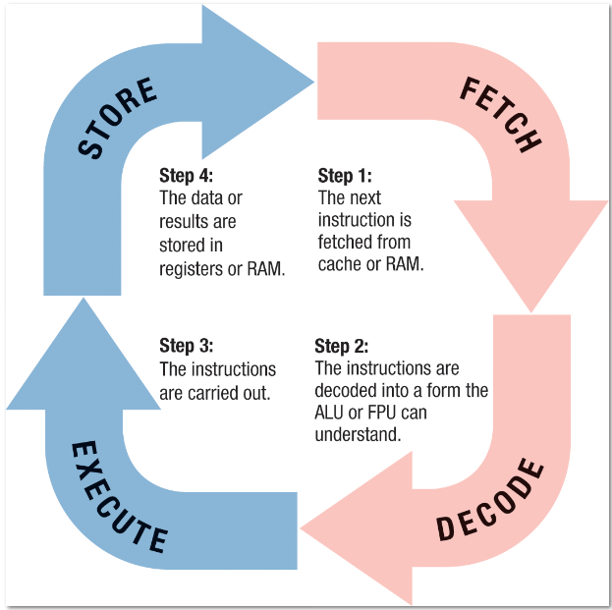
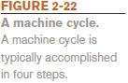
The Machine Cycle
A machine cycle occurs whenever the CPU processes a single piece of microcode
It consists of four operations:
Fetch
Decode
Execute
Store

Slide 61
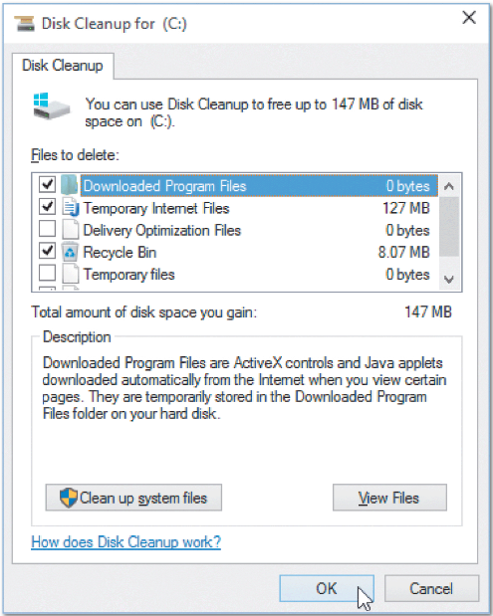
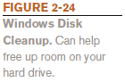
Making Computers Faster and Better Now and in the Future
Improving the Performance of Your System Today
Add more memory
Perform system maintenance
Uninstall programs properly
Remove unnecessary programs from the Startup list
Place unneeded large files on external storage
Delete temporary files
Error-check your hard drive
Scan for viruses and spyware
Clean out the dust

Slide 62
Making Computers Faster and Better Now and in the Future (cont’d)
Buy a larger or second hard drive
Can be internal or external
Move files from your primary drive to make it faster
Upgrade your Internet connection
Various types of connections and speeds are available
Upgrade your video graphics card
PCs with integrated graphics can typically have a graphics card added
Graphics cards can be upgraded if needed
Some notebooks switch to integrated graphics when using battery power to extend battery life

Slide 63
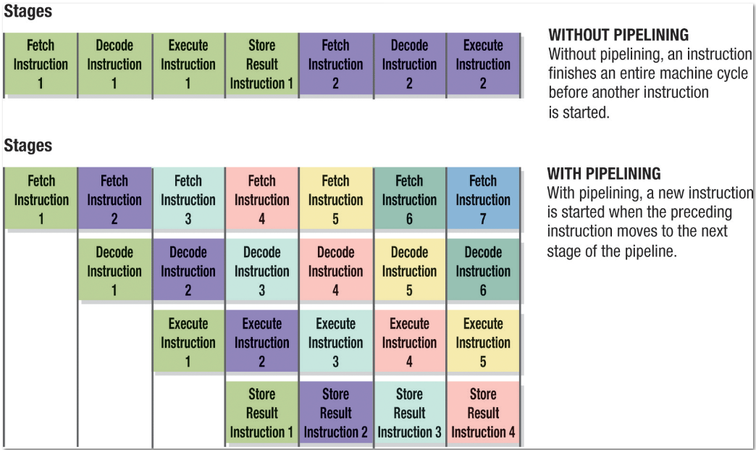

Strategies for Making Faster and Better Computers: Pipelining
Pipelining allows multiple instructions to be processed at one time
A new instruction begins as soon as the previous instruction completes a stage of the machine cycle

Slide 64
Multiprocessing and Parallel Processing
Using more than one processor or processor core is common today
Multiprocessing: Each processor or core typically works on a different job to process these jobs faster than with a single processor
Parallel processing: Multiple processors or cores work together to process a single job as fast as possible
Multithreading: the ability of a CPU (or software) to execute multiple streams of instructions (called threads) within a single program at the same time

Slide 65
Improved Architecture and Materials
Improved architecture
Smaller components, faster memory, faster bus speeds, increasing number of CPU cores, integrated GPUs, support for virtualization, and increased 3D graphics processing
Improved materials
Traditionally, CPUs used aluminum circuitry on silicon chips
Alternate materials include copper chips, and high-k, germanium and other III-V materials
Graphene consists of flat sheets are carbon one atom tall
Lightest and strongest known material
Graphene chips are faster than silicon chips and require less power

Slide 66


Improved Architecture and Materials (cont’d)
Improved materials (cont’d)
Flexible electronic components
Can be bent without damaging circuitry
Thinner, lighter, generate less heat, and consume less power than conventional processors
Needed for flexible devices, wearable clothing, etc.

Slide 67

Trend
Smart Clothing
Is the next trend in wearable technology
Contains flexible circuitry and sensors, wireless connectivity, and a battery
Can monitor your physical activity
Transmits 3D information about your activities
Syncs data to your smartphone
Smart fabric is under development
Smart fabric.

Slide 68


3D Chips
3D chips pack a number of components layered onto small chips
Cuts down on the surface area required
Especially important with notebook computers and mobile devices
Memory cells are stacked on top of one another in layers
For CPUs, the transistors are layered

Slide 69
Nanotechnology
Nanotechnology is the science of creating tiny computers and components less than 100 nanometers in size
Carbon nanotubes (CNTs) are tiny, hollow tubes of graphene
Great potential for many applications
Used in TVs, solar cells, light bulbs, consumer products like surfboards, and computing products like memory
Carbon nanotube fibers conduct heat and electricity like a metal wire
Nanofilters that can remove contaminants from water sources
Nanosensors that can detect cancer-causing toxins or cancer drugs inside single living cells

Slide 70




Examples of Nanotechnology

Slide 71
Terascale/Exascale Computing
High-performance computing (HPC)
Terascale computing is the ability of a computer to process one trillion floating point operations per second (teraflops)
Research is focusing on creating multi-core processors with tens to hundreds of cores used in conjunction with multithreaded hardware and software to achieve teraflop performance
The next development is expected to be exascale computing that can process data at exaflop (1,000 petaflops) speeds

Slide 72


Quantum Computing
Quantum computing applies the principles of quantum physics and quantum mechanics to computers
Utilizes atoms or nuclei working together as quantum bits (qubits)
Qubits function simultaneously as the computer’s processor and memory and can represent more than two states
Used for specialized applications, such as encryption and code breaking

Slide 73
Optical Computing and Silicon Photonics
Optical computers use light to perform digital computations
Can be smaller and faster than electronic computers
Opto-electronic computers use both optical and electronic components
Silicon photonics uses light for data transfers within and among silicon chips
Expected to be used to transfer very large quantities of data at very high speeds between chips in servers, mainframes, and supercomputers

Slide 74
In-Class Discussion
Define ROM (read-only memory). What is one important difference between ROM and RAM (random access memory)?
What are the general operations of a machine cycle?
Discuss the design a hypothetical computer of tomorrow, the equivalent of a desktop or notebook PC today. How big would the computer be? Would it be portable or built into furniture or some other object? Should it be wearable or embedded in a person’s body? What is the ideal computer of the future?
Discuss products that use computer chips and microprocessors today. What functions the chips provide to their stated products? Discuss other products that would benefit from the inclusion of a processor in the future? What about products that would be improved if they included built-in computer processing abilities?

